Slide 1
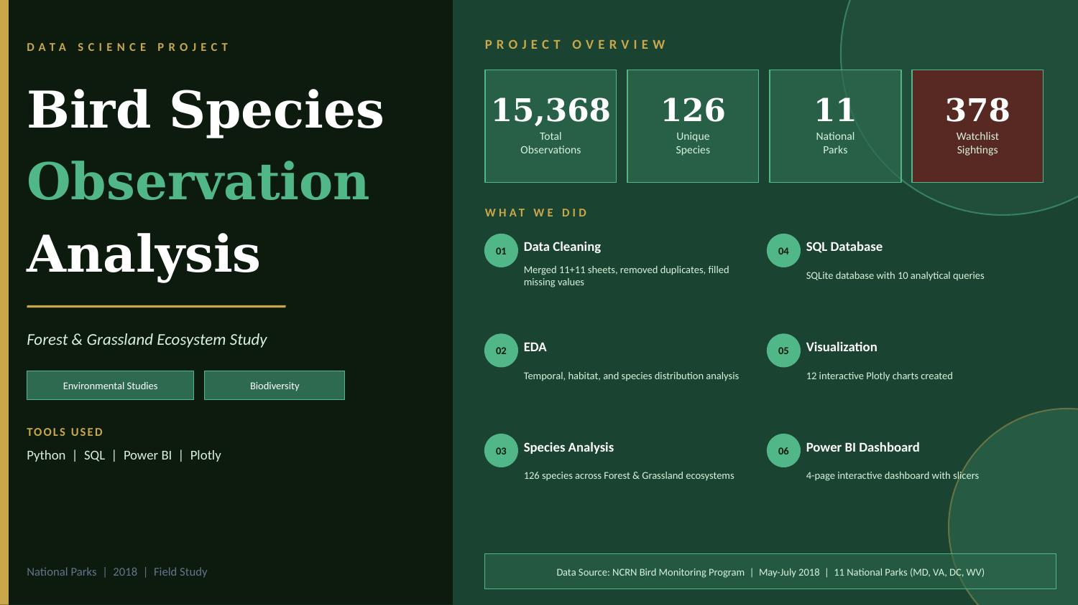

Slide 2
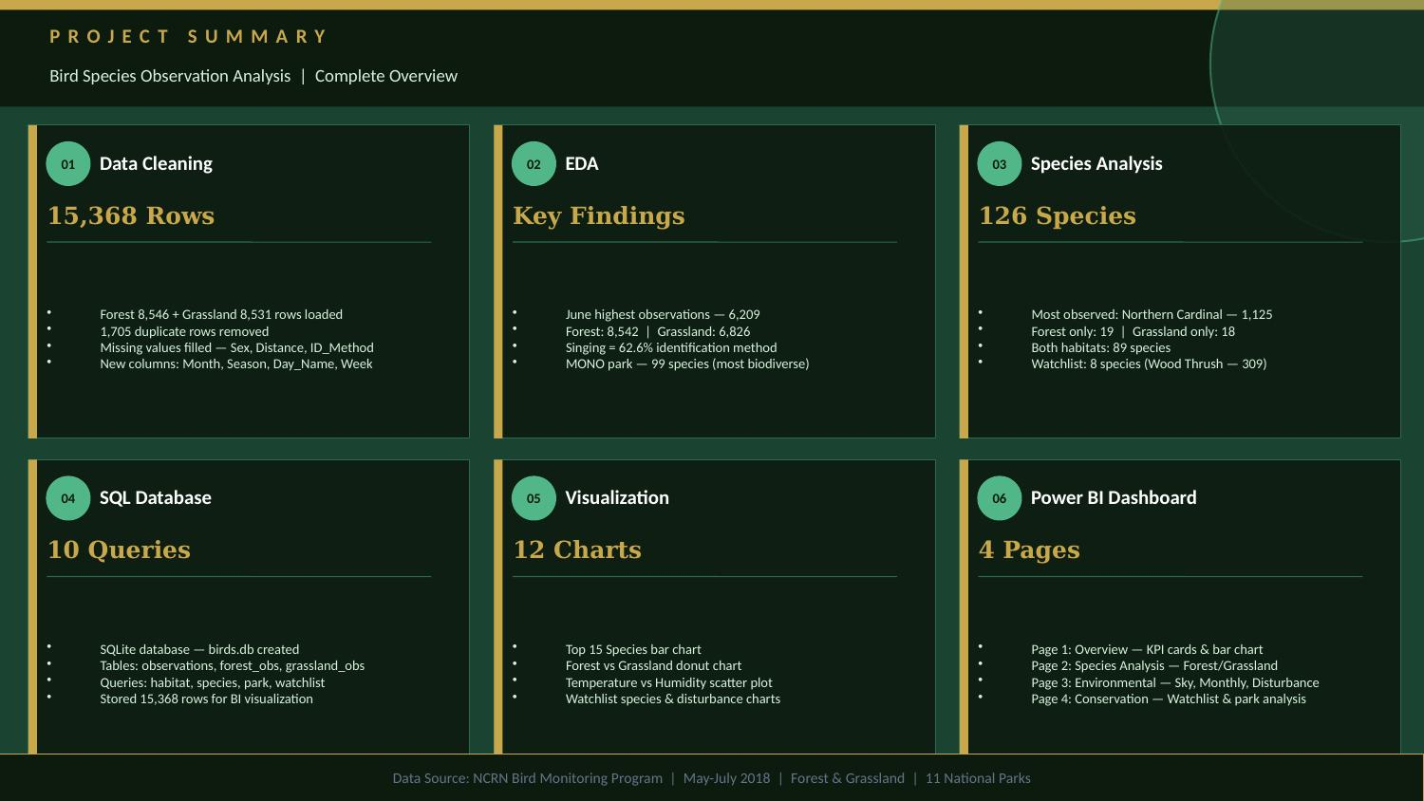

Slide 3
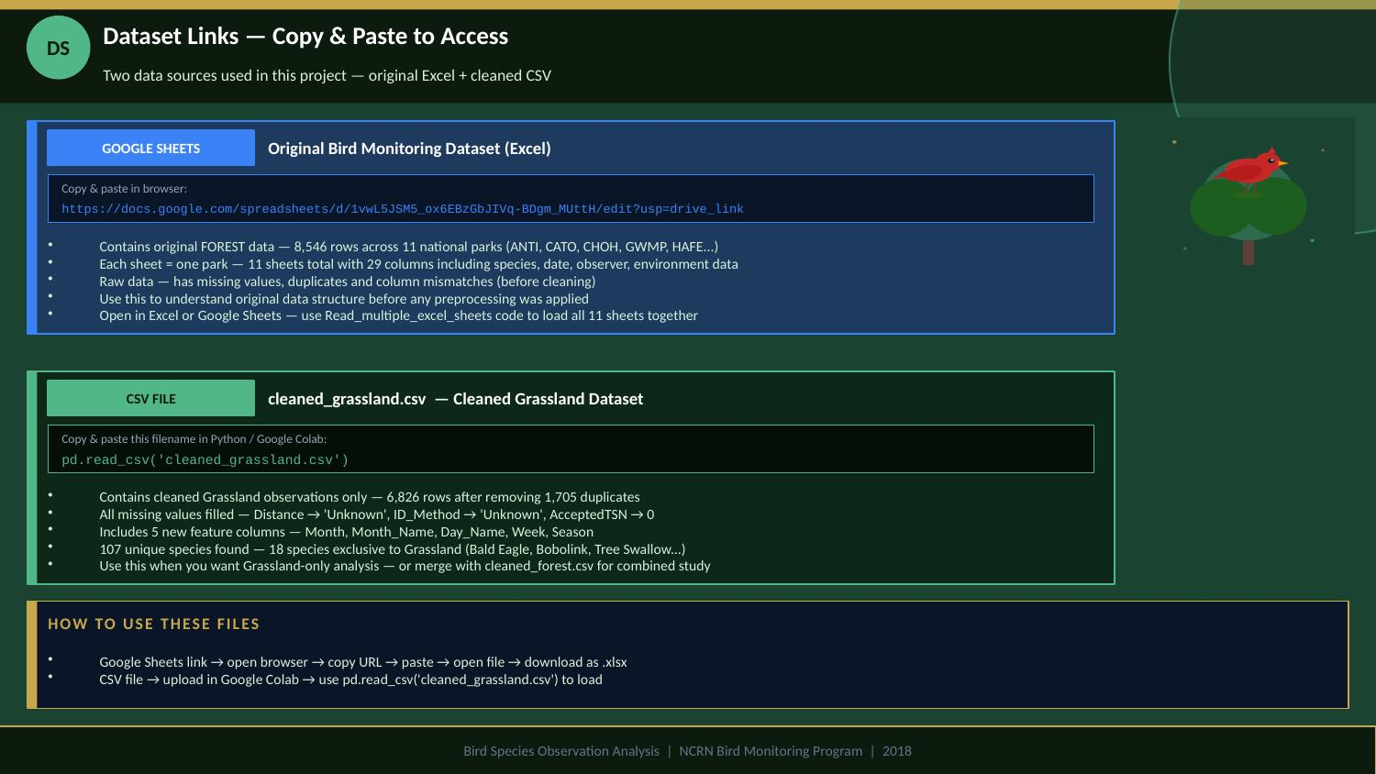

Slide 4
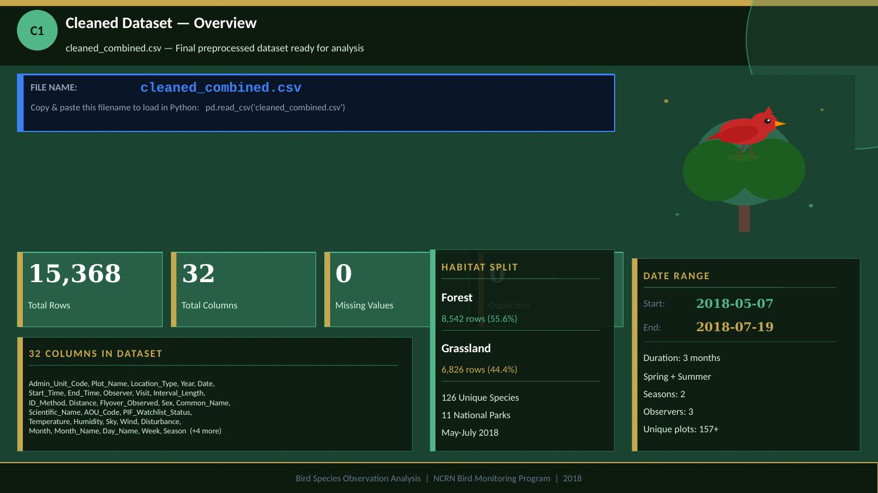

Slide 5
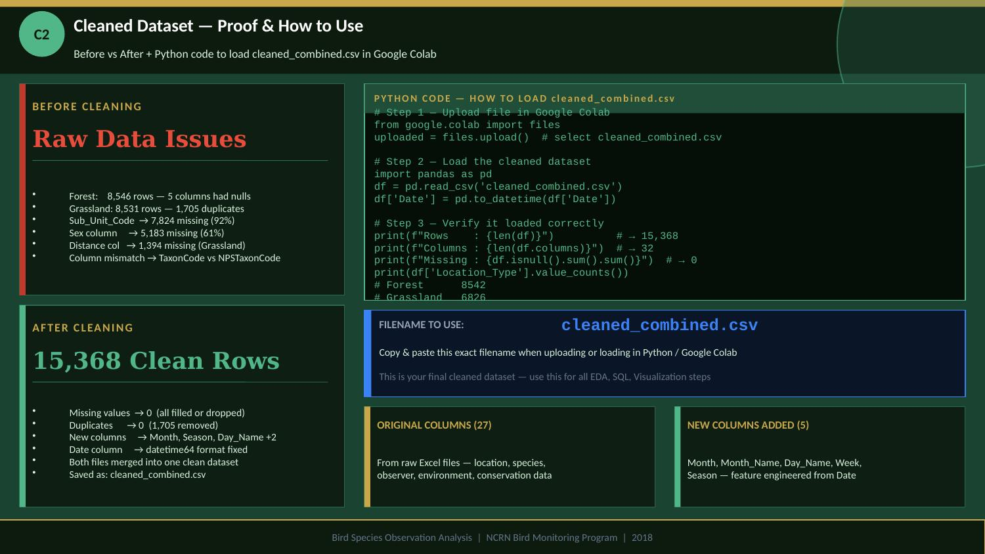

Slide 6
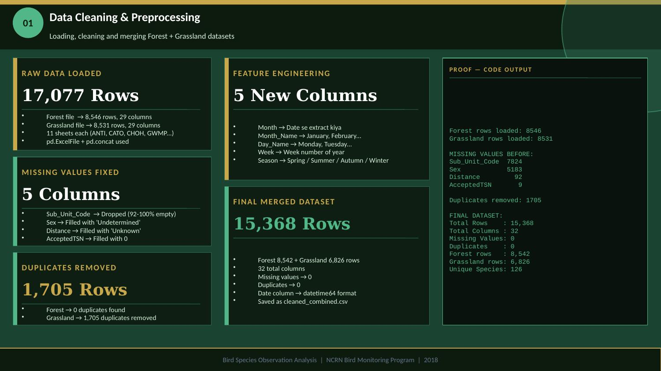

Slide 7
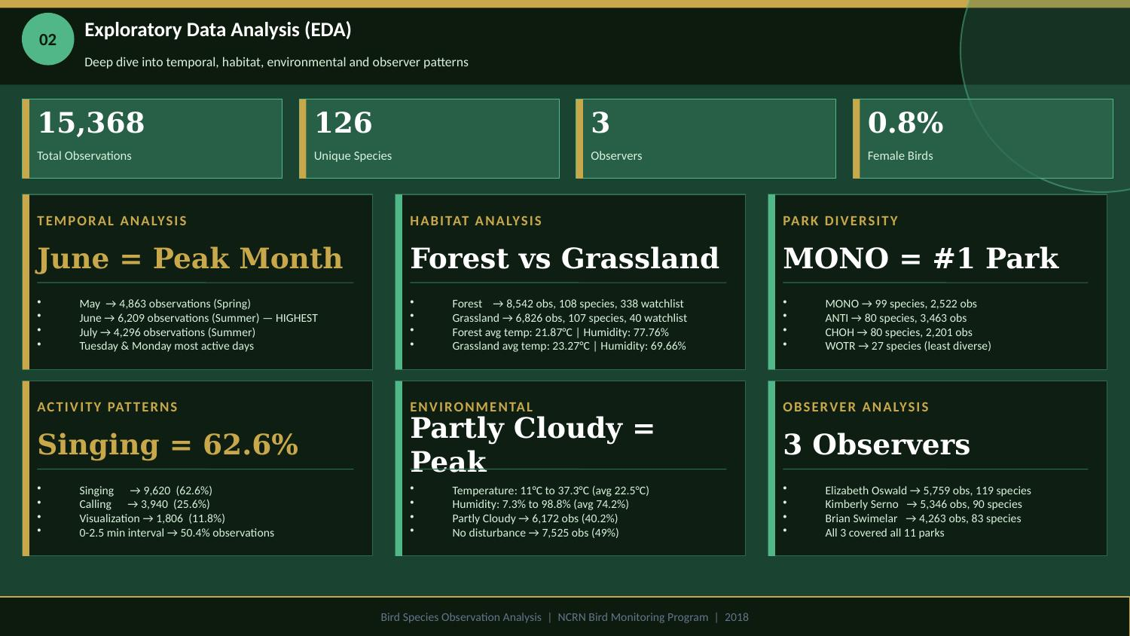

Slide 8
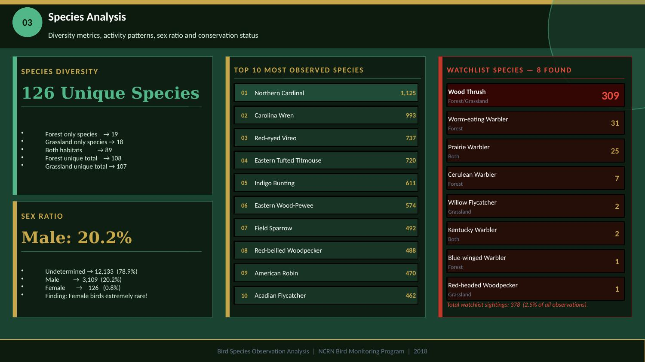

Slide 9
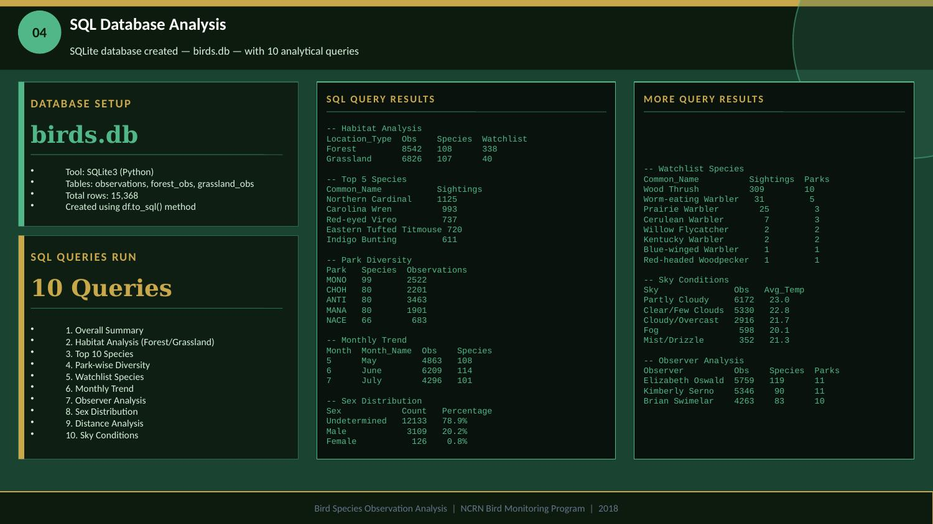

Slide 10
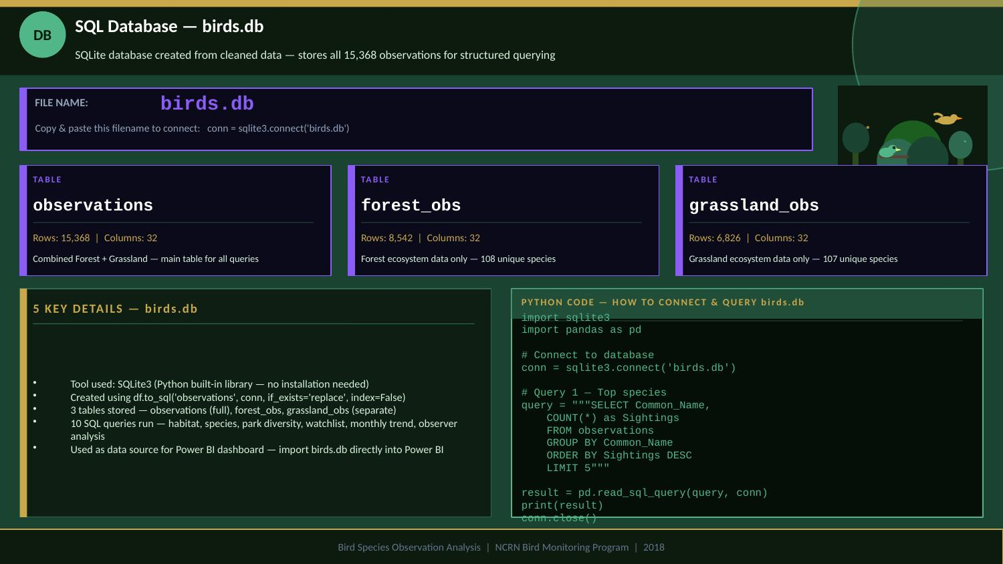

Slide 11
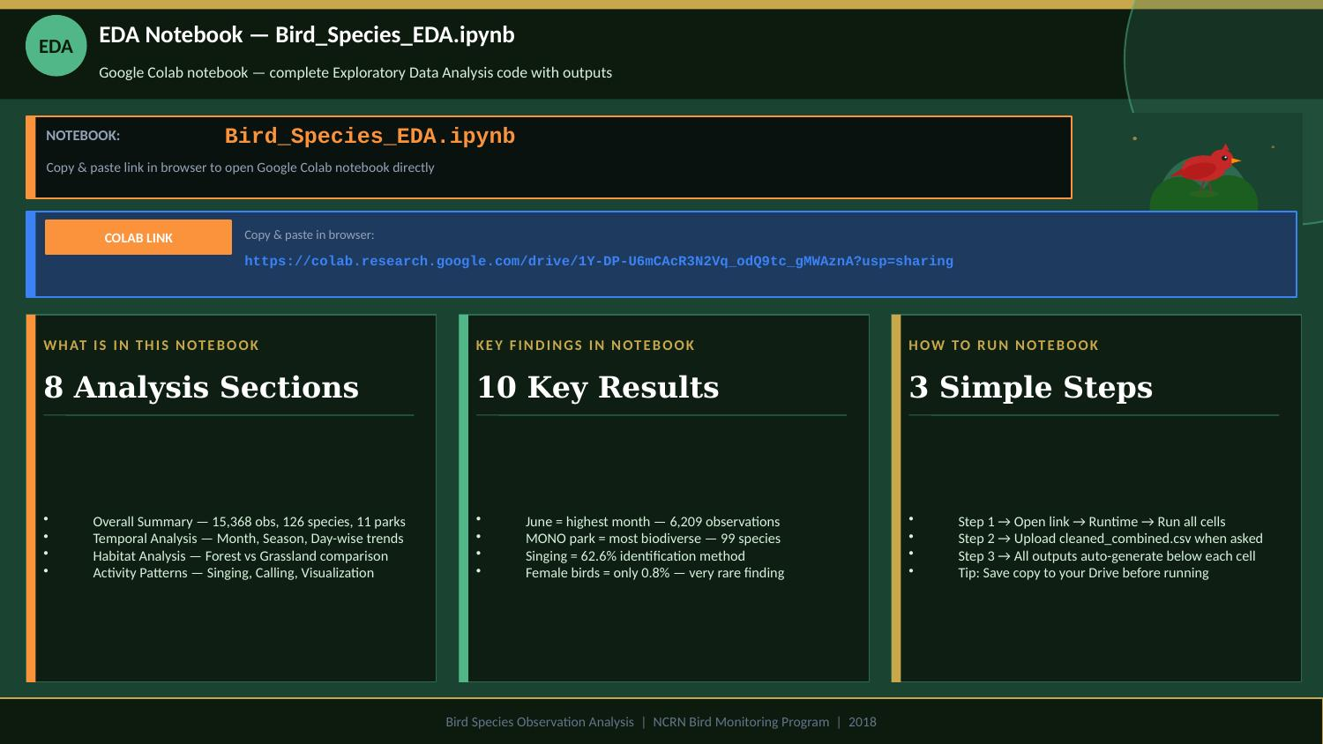

Slide 12
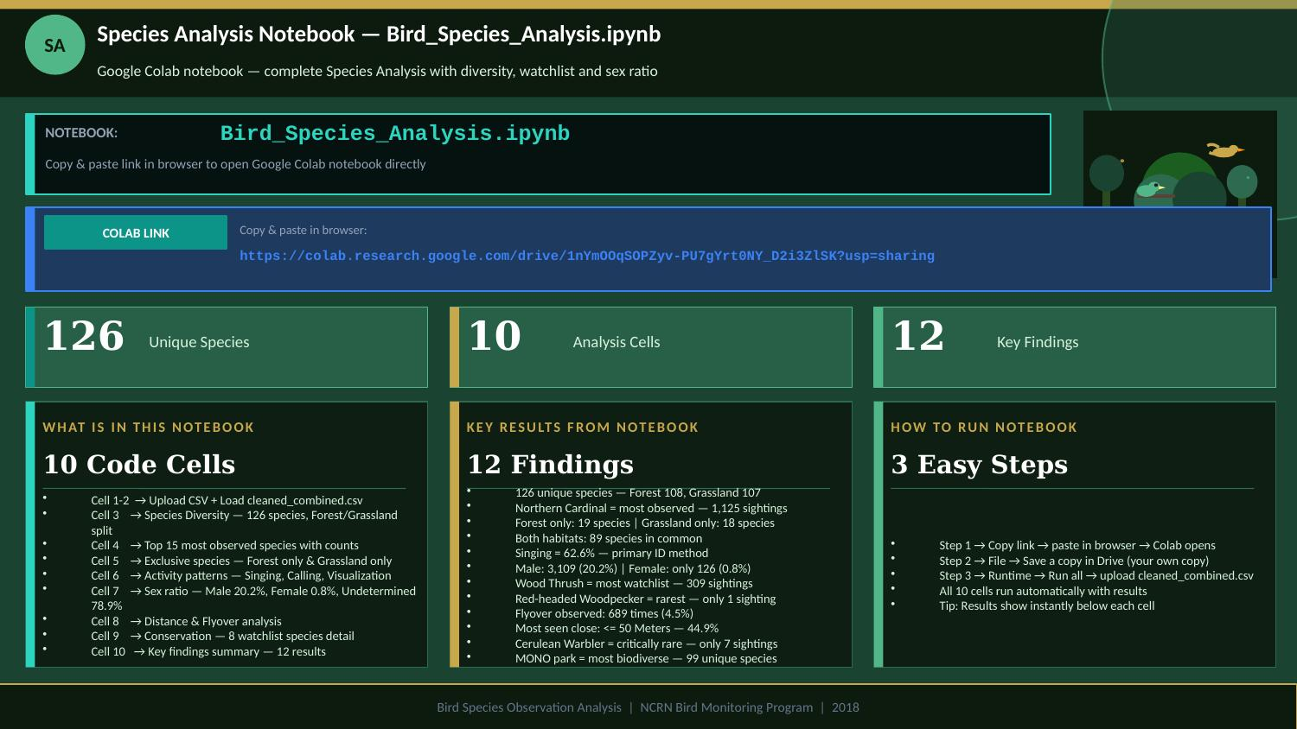

Slide 13
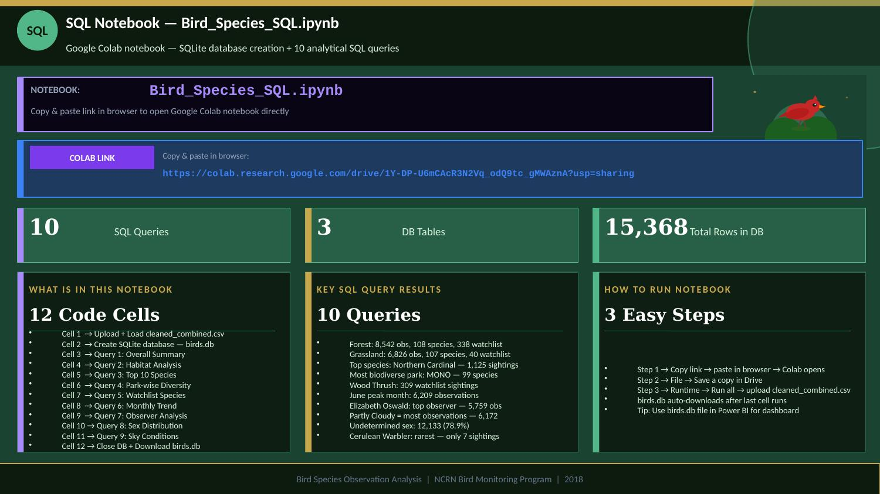

Slide 14
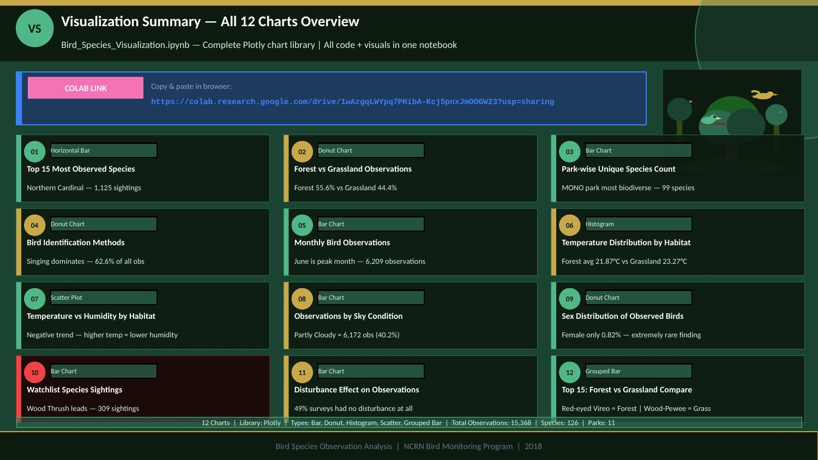

Slide 15
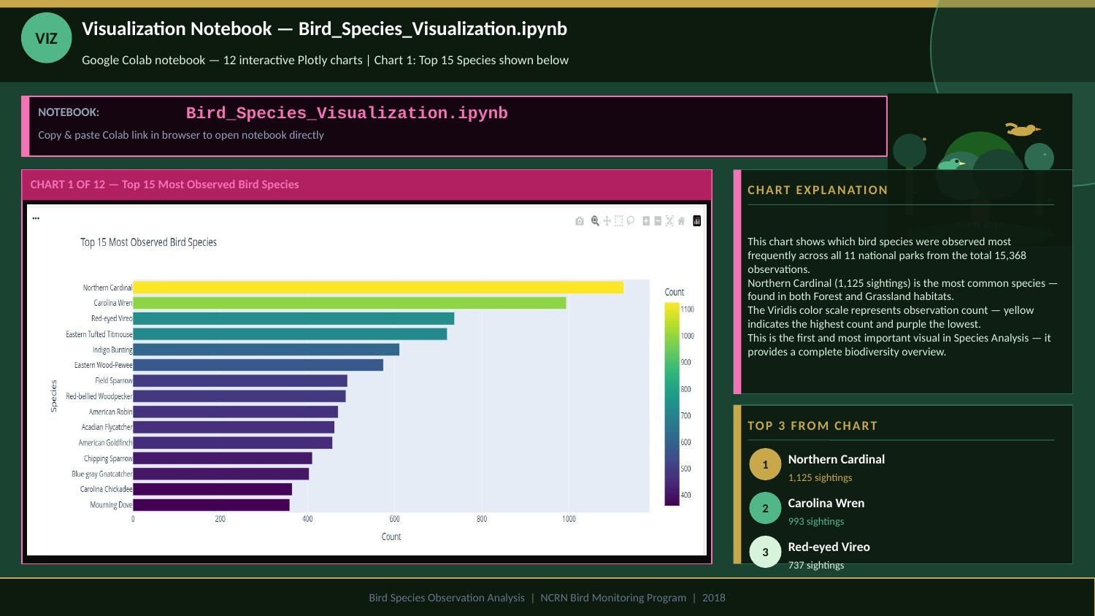

Slide 16
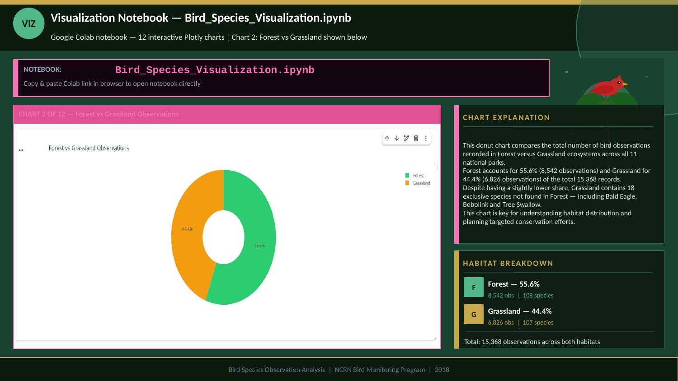

Slide 17
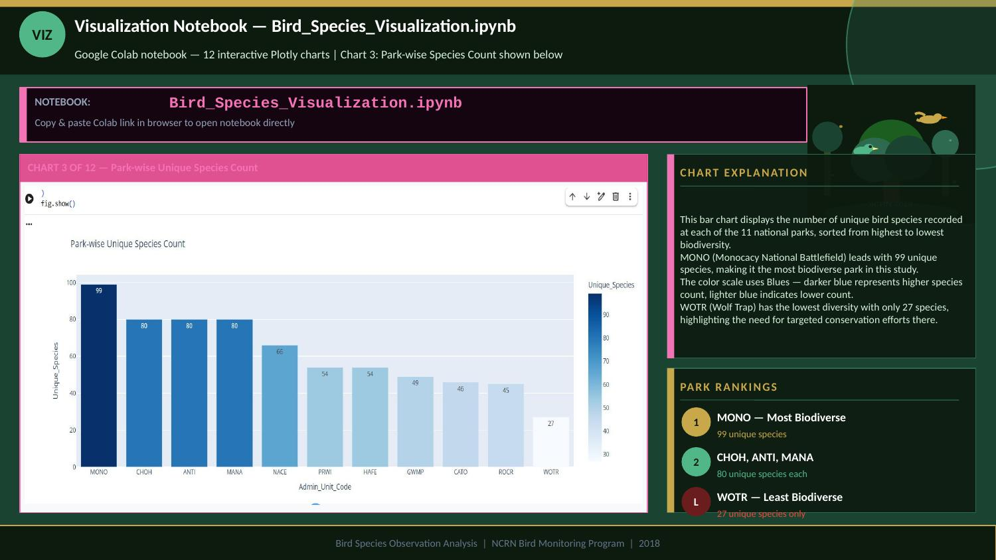

Slide 18
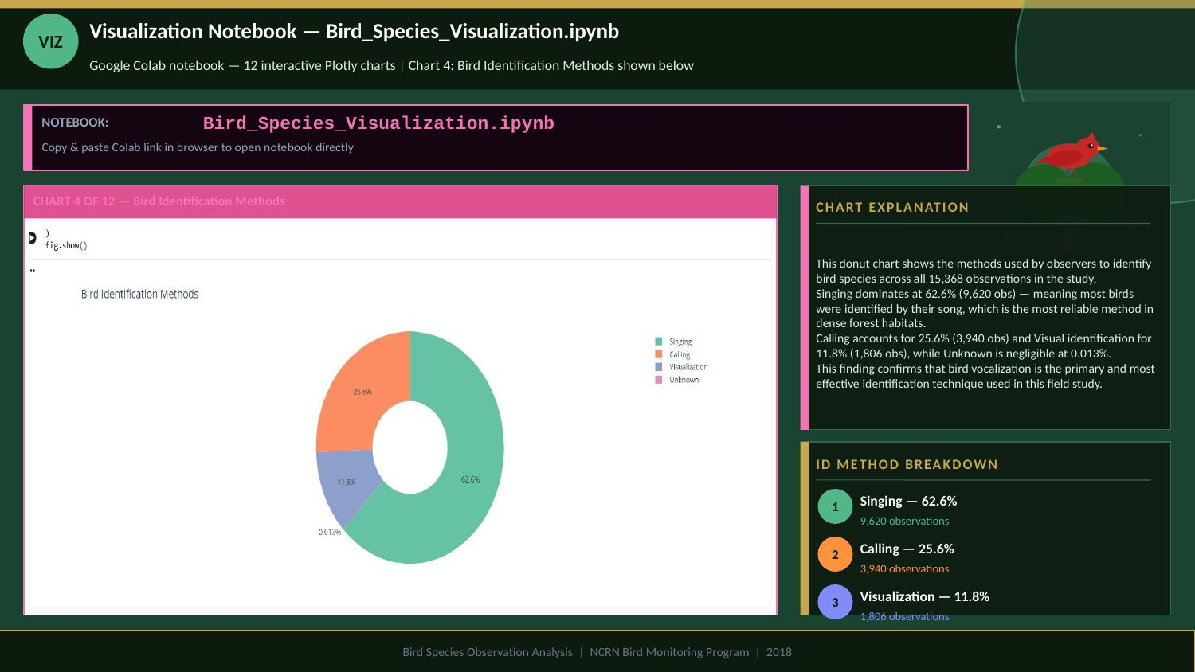

Slide 19
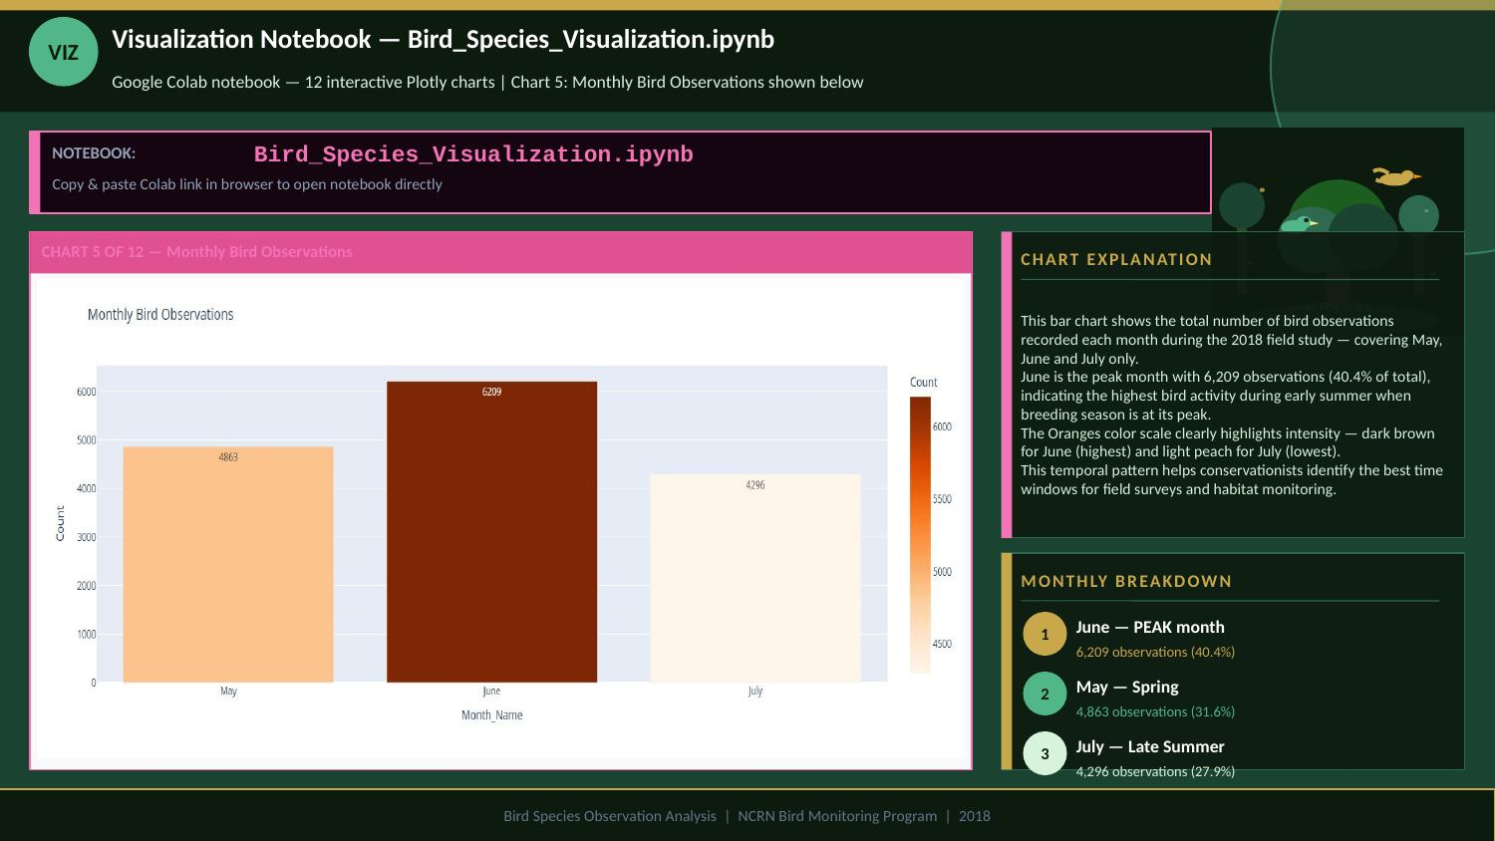

Slide 20
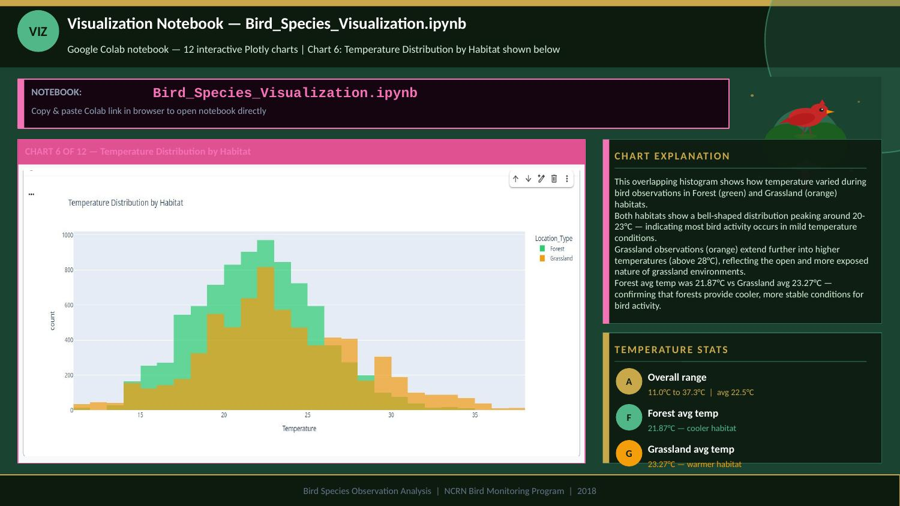

Slide 21
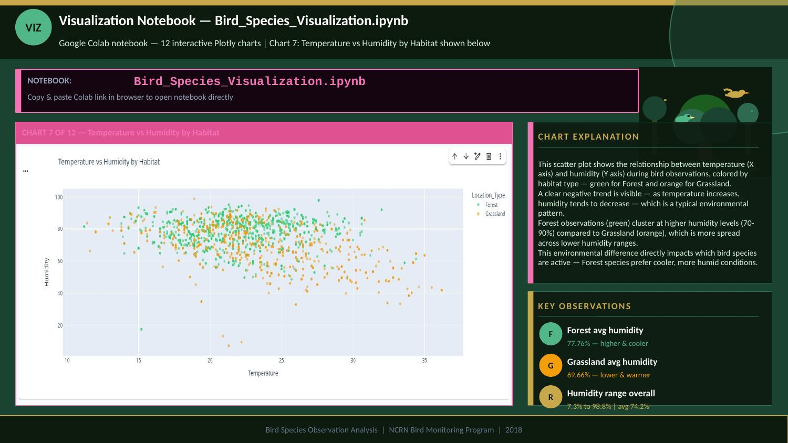

Slide 22
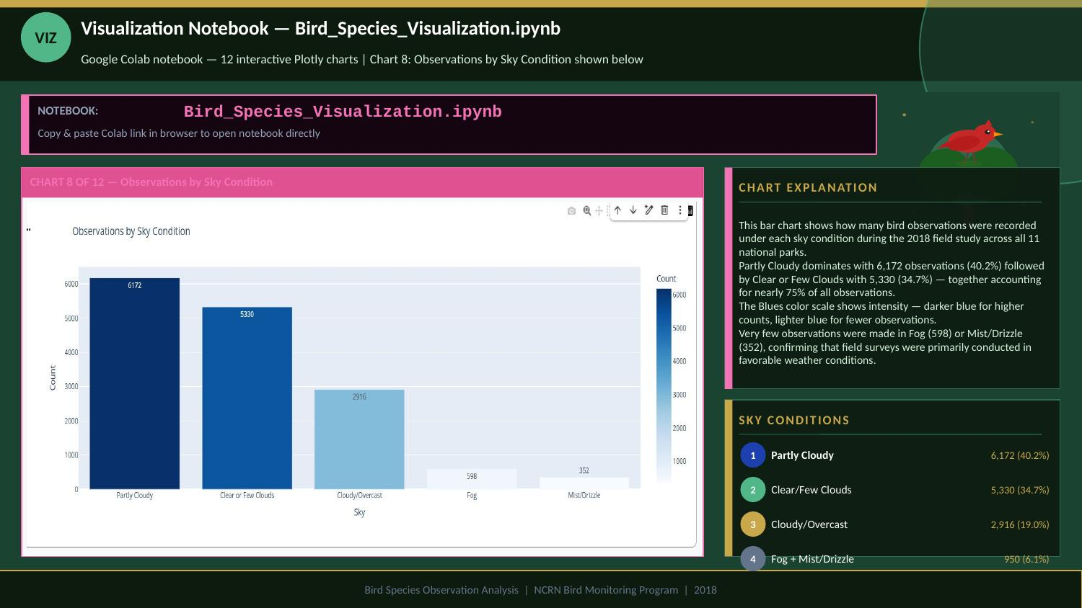

Slide 23
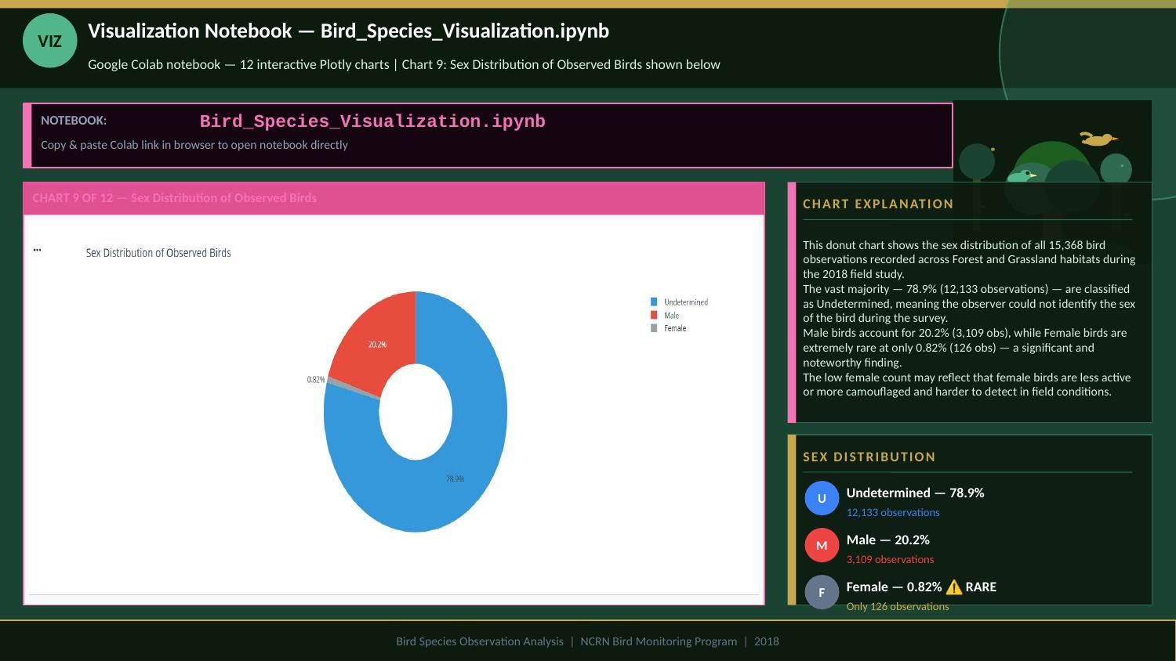

Slide 24
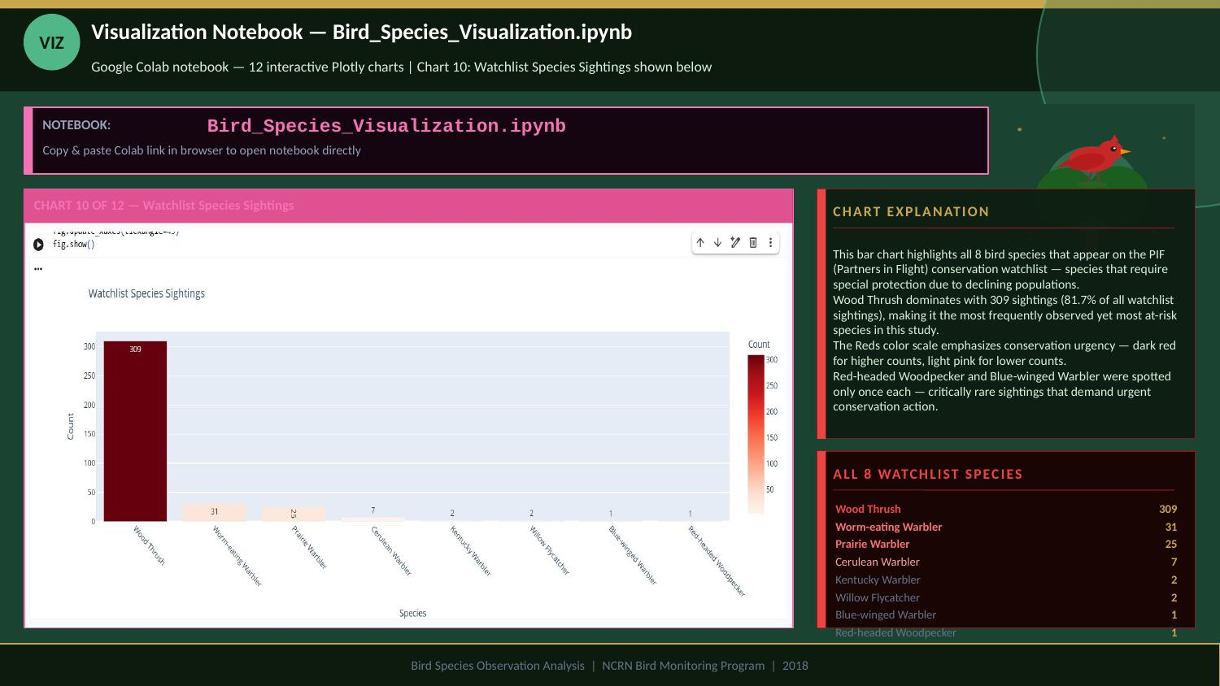

Slide 25
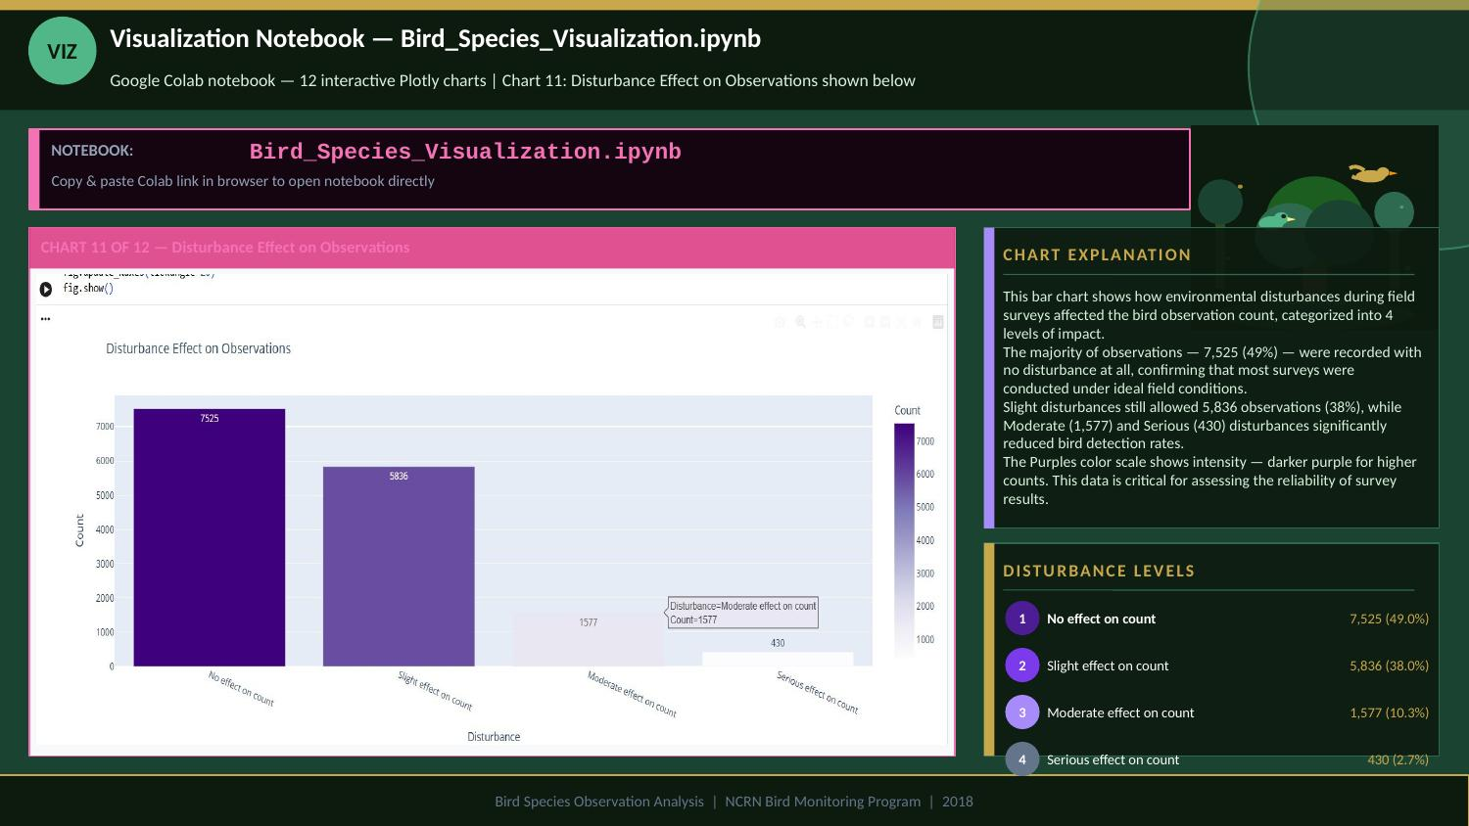

Slide 26
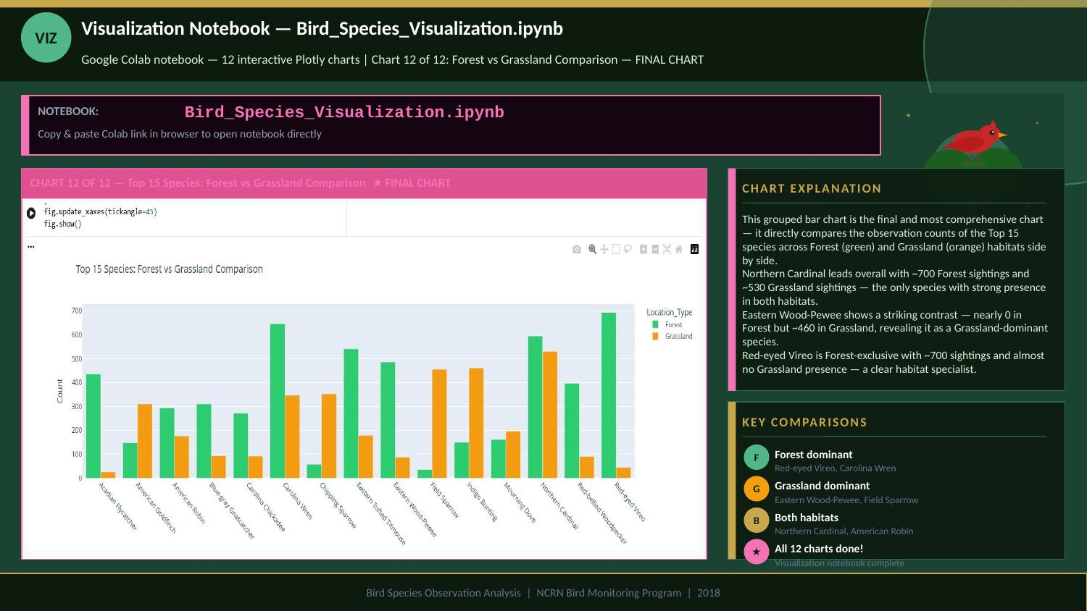

Slide 27
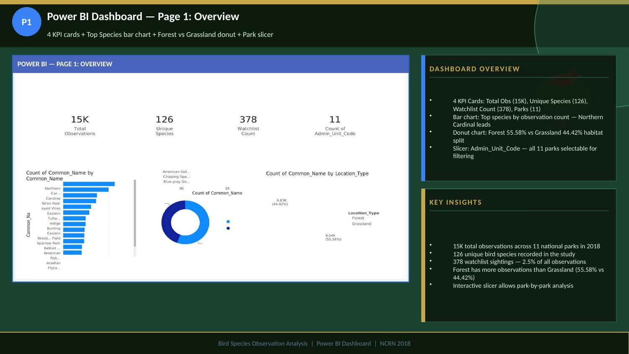

Slide 28
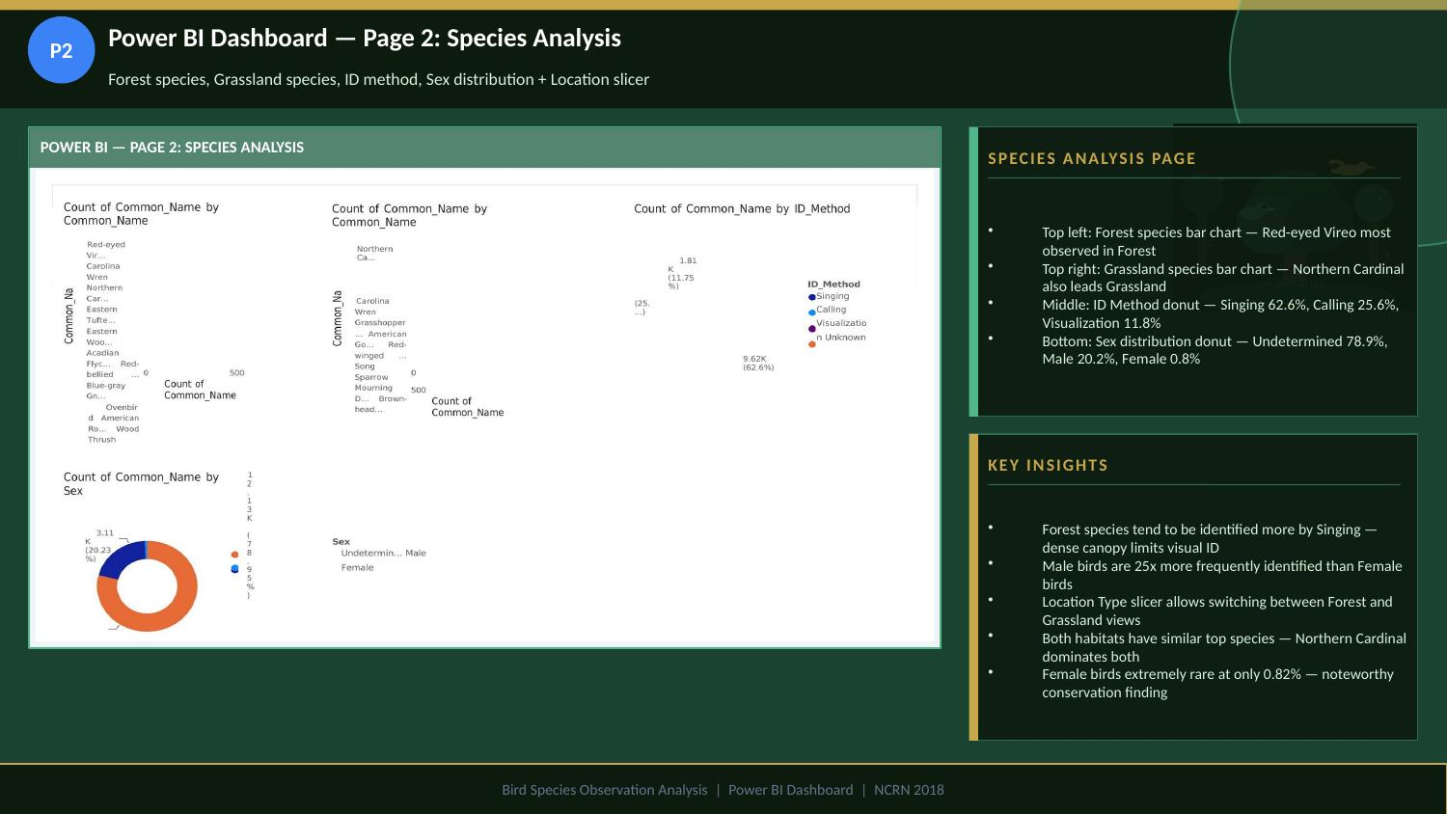

Slide 29
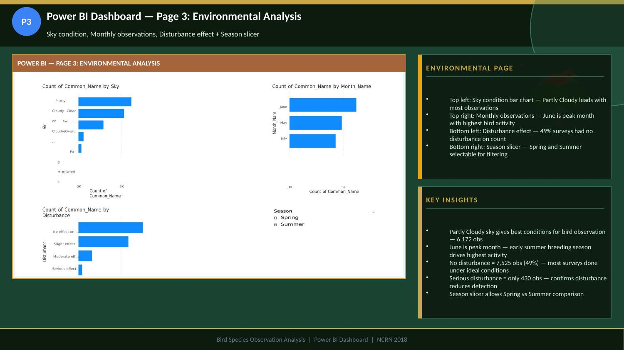

Slide 30
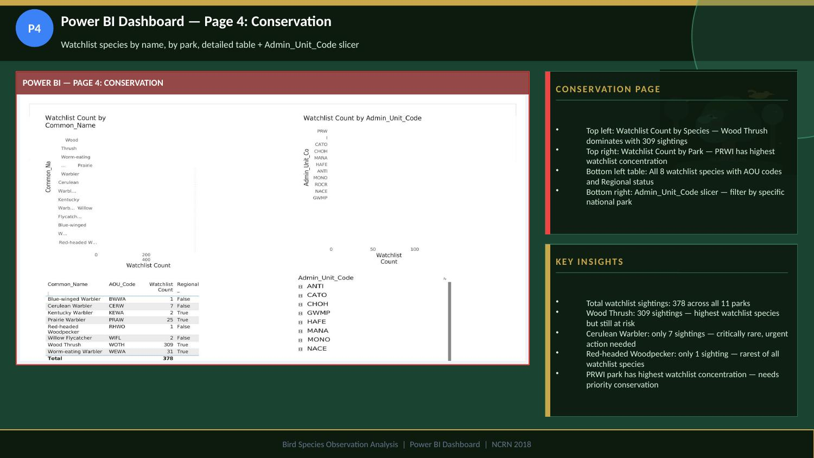

Slide 31
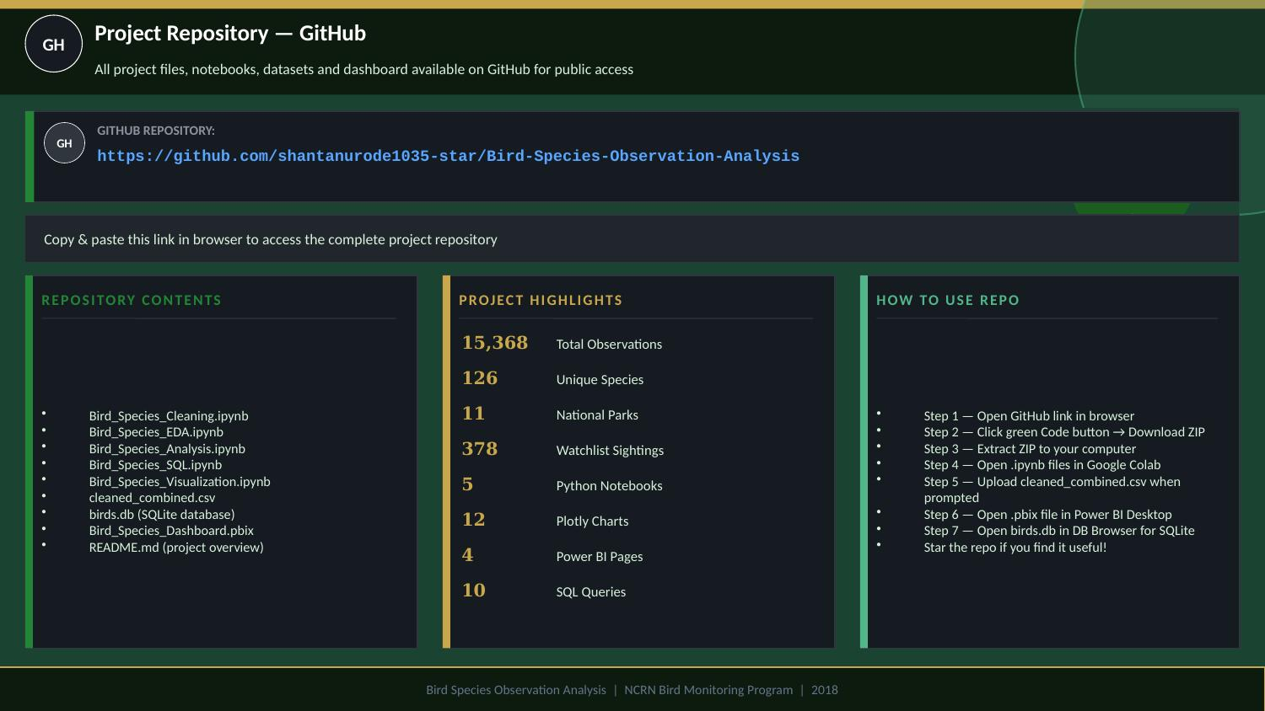

Slide 32
ALL PROJECT LINKS
Click any link to open | Select text + Ctrl+C to copy
Google Sheets — Original Dataset
https://docs.google.com/spreadsheets/d/1vwL5JSM5_ox6EBzGbJIVq-BDgm_MUttH/edit?usp=drive_link
01
Bird_Monitoring_Data_FOREST + GRASSLAND
EDA Notebook — Bird_Species_EDA.ipynb
https://colab.research.google.com/drive/1Y-DP-U6mCAcR3N2Vq_odQ9tc_gMWAznA?usp=sharing
02
Exploratory Data Analysis | Google Colab
Species Analysis — Bird_Species_Analysis.ipynb
https://colab.research.google.com/drive/1nYmOOqSOPZyv-PU7gYrt0NY_D2i3ZlSK?usp=sharing
03
Species Diversity & Watchlist | Google Colab
SQL Notebook — Bird_Species_SQL.ipynb
https://colab.research.google.com/drive/1Y-DP-U6mCAcR3N2Vq_odQ9tc_gMWAznA?usp=sharing
04
SQLite Database & 10 Queries | Google Colab
Visualization — Bird_Species_Visualization.ipynb
https://colab.research.google.com/drive/1wAzgqLWYpq7PHibA-Kcj5pnxJmOOGW23?usp=sharing
05
12 Interactive Plotly Charts | Google Colab
GitHub Repository — Complete Project
https://github.com/shantanurode1035-star/Bird-Species-Observation-Analysis
06
All files, notebooks, dataset & Power BI dashboard
Bird Species Observation Analysis | NCRN 2018 | Select any URL above → Ctrl+C to copy

Slide 33
